Slide 1
STEM careers at Control Techniques

Slide 2

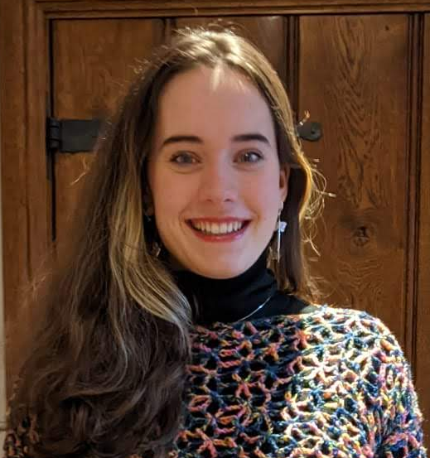

Hi!
Development Engineers
Alex
Kitty
Dom
Global Test Development
R&D Power Electronics
R&D Functional Safety
Test Machine Design
Drive Test Software Development
Process and Operations Management
Power Electronics
EMC Testing and Design
Tech Support
Firmware Development (code)
Software Development (code)
Safety, Networking, Automation
Notes:
Who are we? No-one may ever know

Slide 3
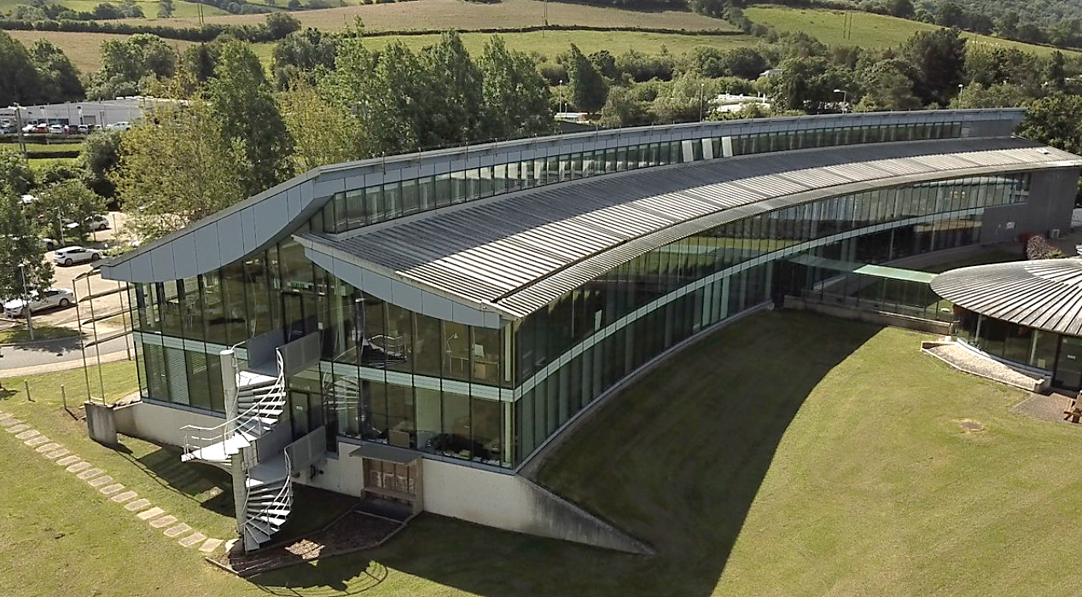
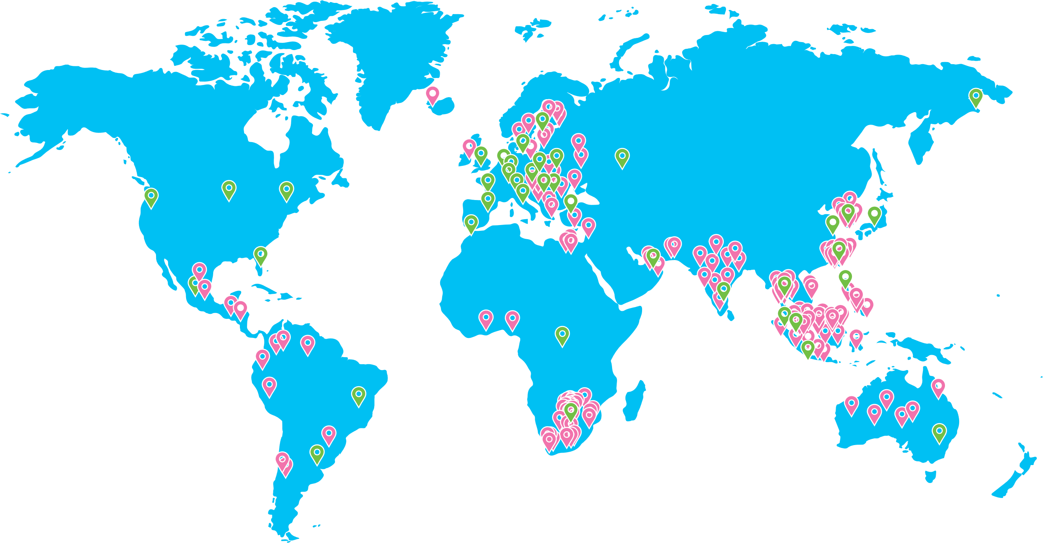

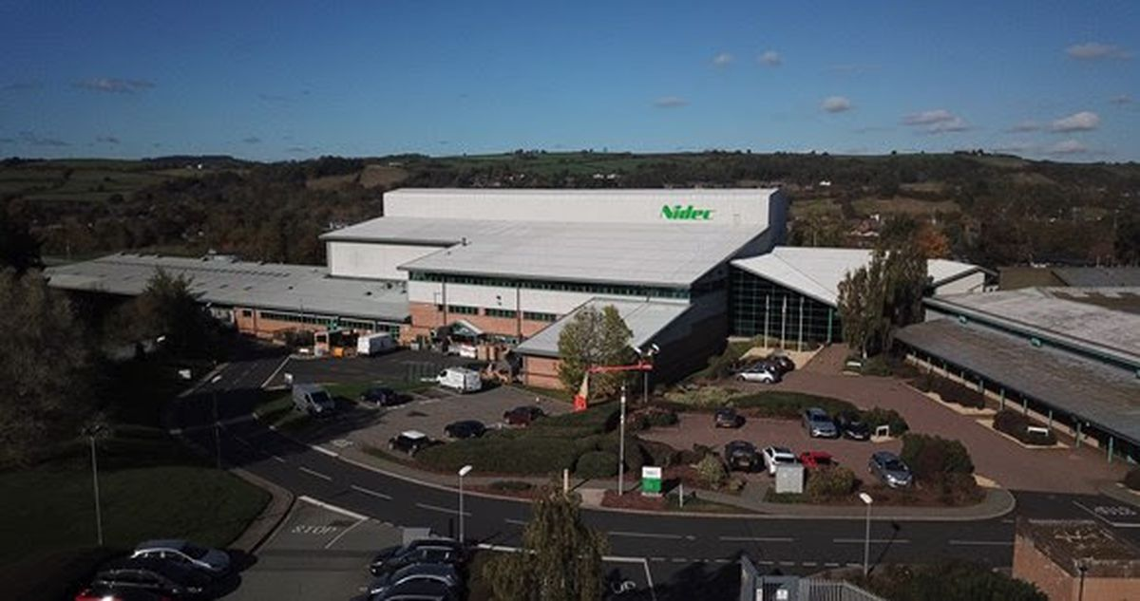
Where are we based?
Newtown, Powys
R&D Headquarters
Engineering & Design Coral Springs, Florida
Newtown
Head Office, Newtown
Small Drives
Jabil, Guanghou, China
Manufacturing Plant
Large Drives
WKK, Donguan, China
Engineering & Design
Shenzhen, China
PV System facilities
Cluj, Romania
Engineering & Design
Cluj, Romania
Engineering & Design
Pune, India
Notes:
Where do we work? Only half an hour away!
International centers also available

Slide 4

What do we do?
Notes:
https://www.youtube.com/watch?v=TllD5SkSirk

Slide 5
A typical day at our work
Dom
Designing and writing embedded firmware to run on products
Designing and writing applications software to run on PCs
Debugging software and firmware
Prototyping new products
Kitty
Answering tech support tickets
Writing tools and programming
Product and software testing
Bug recreation and solution finding
Alex
Remote global test support
Test Calibration and Data Analysis
Prototyping new test machines and programs
Operations Integration

Slide 6

Engineering Sectors
Electrical
Electronic
Mechanical
Process
Computing/Software
Firmware
Applications
Troubleshoot and Repairs
IT
Notes:
K-Electrical- big power, high voltage devices and systems
K-Electronic- small power, active components like semiconductors, controlling current flow
A-Mechanical- how things fit together, physical movement of machinery
A-Process- the efficiency of operations
D-Computing and Software- Coding, programming routines within a whole system
D-Firmware- Similar to software, interacting directly to control hardware of device e.g. embedded systems (processors and memory stuff)
K-Applications- How to use the products efficiently
A-Troubleshoot and Repairs- problem solving
D-IT- computer systems, programs, cyber awareness(?)

Slide 7
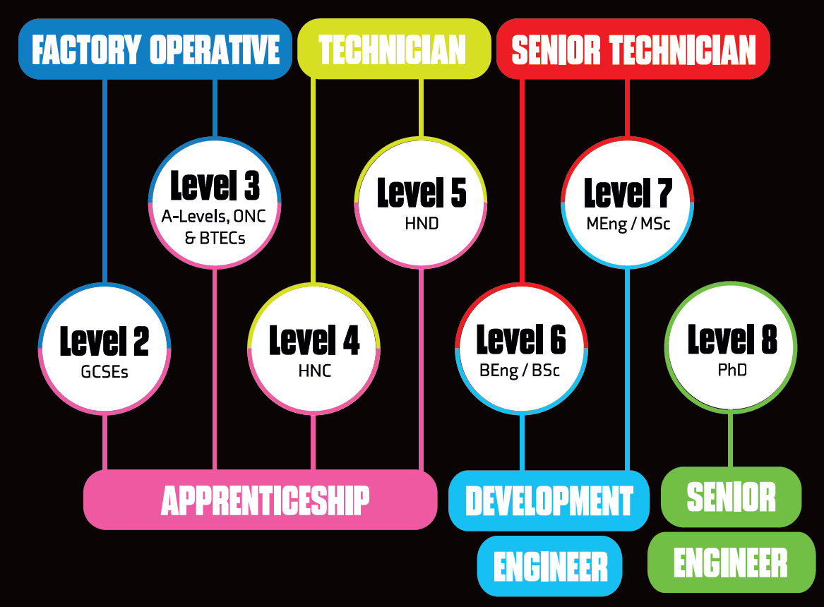
Career Entry Points
Notes:
This does not limit how far you can get!! This is only entry point to begin career path

Slide 8

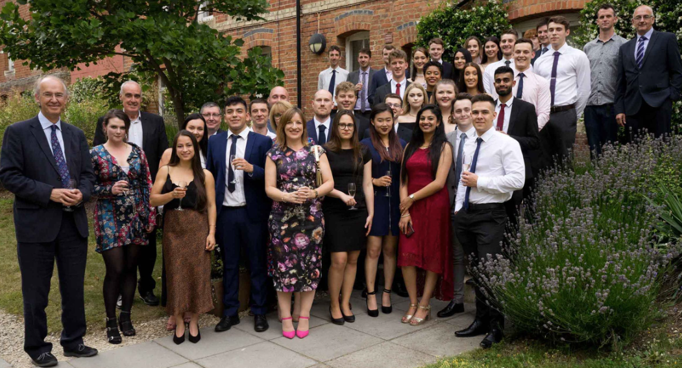
University Sponsorship Program
E3 Academy scholarship
£2500 annual bursary
£2500 annual 8 weeks paid summer internship
£6000 university fee reimbursement
Academy events and annual Summer School
University/Company mentors
Universities of Newcastle, Nottingham, Bristol
Notes:
Big shmoney moves, cheers big paul

Slide 9


Apprenticeship Program
Personalized experience rather than a generic academic plan; individually tailored to specific interests
Same timeframe for achieving qualifications, but alongside on-the-job training
Regular check-in meetings with manager/mentor/tutor
Earned salary instead of student fees/loans
Apprenticeship open days
Notes:
Also shmoney move but important experience too

Slide 10


Graduate Training Program
Internationally recognized IET accredited engineering graduate training program
Fast track path to personal and professional career growth
30% of Engineers in R&D currently achieved/pursuing CEng
6 month rotations for broader experiences

Slide 11
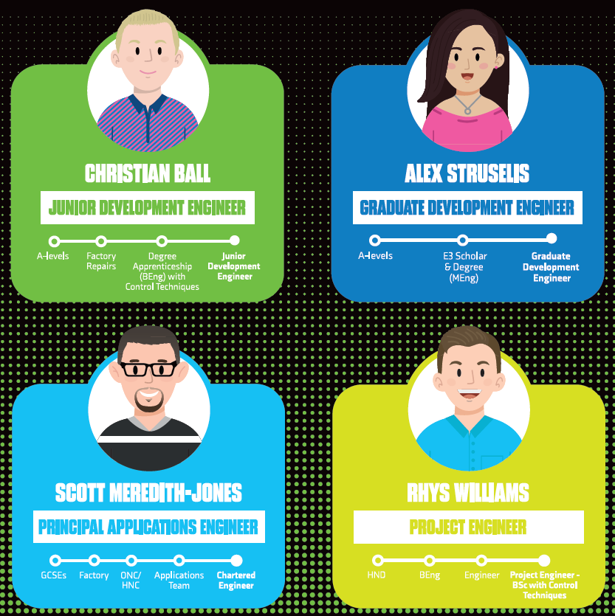
Example Journeys
Notes:
Christian- A levels, work instead of uni, degree apprenticeship with CT
Alex- complete higher education journey
Scott- GCSEs, work instead of A levels, independent HNC, work experience
Rhys- A levels, HND, work, degree with CT

Slide 12
Our education journeys- University
Kitty
GCSEs
A Levels
University
German, French, Latin, History
Maths, Further Maths, Physics, German
MEng Electrical and Electronic Engineering, Nottingham
E3 Academy Sponsorship
Final Project- Optics (Metalenses)
Alex
GCSEs
A Levels
University
History, Geography, Philosophy & Ethics, French
Maths, Physics,
Systems and Control, Economics
MEng Electrical and Electronic Engineering, Newcastle
E3 Academy Sponsorship
Final Project- Bioelectronic Prosthetics
Dom
GCSEs
A Levels
University
Computing, Electronics, German, Statistics
Maths, Physics, Computing
MEng Electronic and Computer Engineering, Nottingham
E3 Academy Sponsorship
Final Project- Computer vision driver assistance
Notes:
GCSEs- in addition to mandatory Maths, English and Science

Slide 13
Could you be an engineer?
Problem Solving
Logic and Reasoning
Step by step methods
Creativity
Inventing things
Hands-on practical activities

Slide 14
Question time!
Our contact details will be with your teachers if you want to ask anything further ☺

